Slide 1
Get Lucky and Maximize Opportunity notice and act on chance opportunities Trust Your intuition Persevere in the face of criticism and rejection See the positive side of unlucky events
Richard Wiseman and Helen Sword
Notes:
https://richardwiseman.wordpress.com/research/luck-and-self-development/

Slide 2
Artisanal Habits

Slide 3

Crafty Writing
Learning to write
The writing craft
Writing in other languages

Slide 4
To be a successful academic, it is not enough merely to have mastered the craft of writing intelligibly. You must also be creative enough to produce original research, …
Helen Sword, author of Air & Light & Time & Space: How Successful Academics Write

Slide 5
… persuasive enough to convey the significance of your findings to others, prolific enough to feed the tenure and promotion machine, …
Helen Sword, author of Air & Light & Time & Space: How Successful Academics Write

Slide 6
… confident enough to withstand the slings and arrows of peer review, strategic enough to pick your way safely through the treacherous terrain of academic politics, …
Helen Sword, author of Air & Light & Time & Space: How Successful Academics Write

Slide 7
… well organized enough to juggle multiple roles and commitments, and persistent enough to keep on writing and publishing no matter what.
Helen Sword, author of Air & Light & Time & Space: How Successful Academics Write

Slide 8
A lot of students make the mistake of comparing their beginning efforts with other people’s final products.
Helen Sword, author of Air & Light & Time & Space: How Successful Academics Write

Slide 9
Things To Try

Slide 10
Artisanal Habits – Things to Try
Reflect
How, where, when, and from whom did you learn to write?
Strengths and gaps?
Emulate
Learn by teaching
Read

Slide 11
Artisanal Habits
Swap services
Pay it forward
Find your emotional language
Read
Academic Writing – Stephen Bailey
Graduate and Scholarly Writing – Sheryl Holt

Slide 12
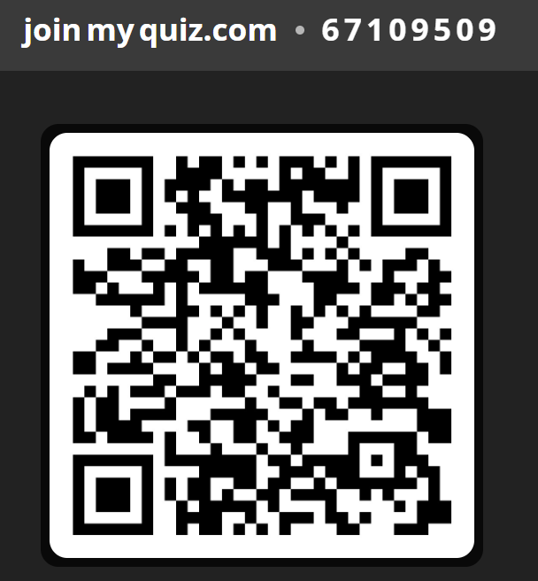

Slide 13

Discussion

Slide 14
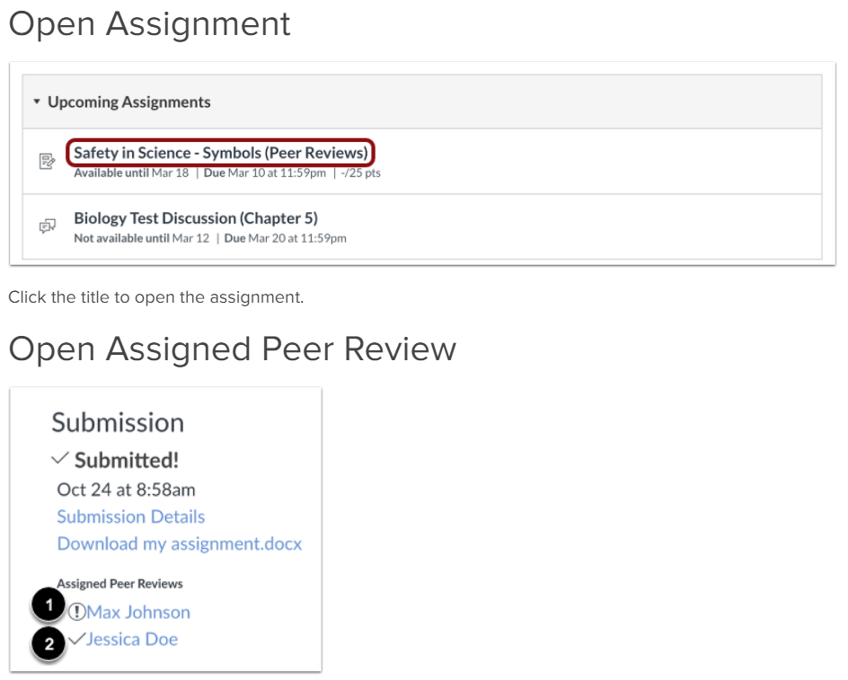

Slide 15
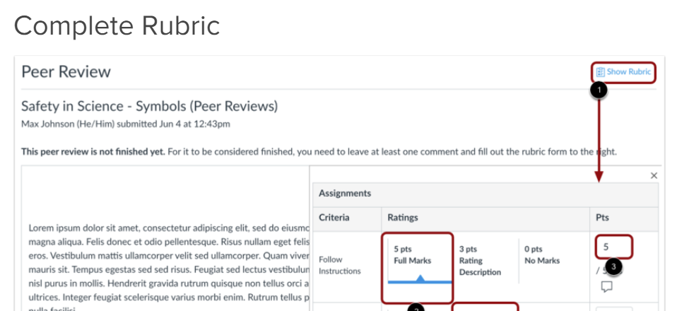

Slide 16
Conflicting Edits/Advice
Use the opinions to make an informed choice
Order of preference
Journal requirements
Supervising faculty requirements
Your conscious decision
Everyone else’s opions

Slide 17
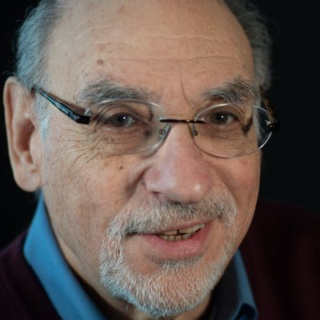
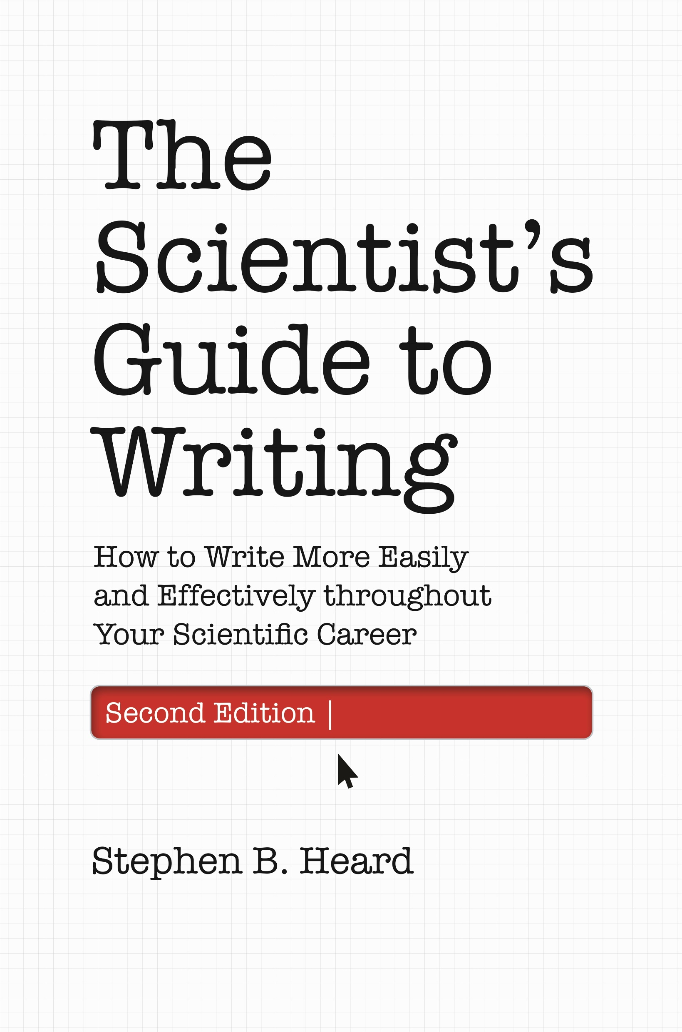
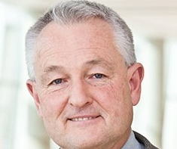
Sources and Inspiration
Stephen Heard, UNB, author of The Scientist Guide to Writing
Irving H. Zucker, UNMC
& Myron Toews, UNMC

Slide 18

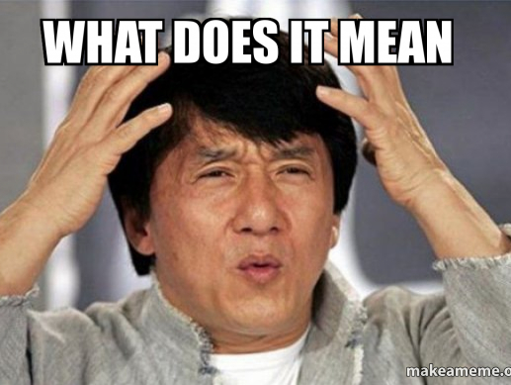
Why
Interpret results
Provides meaning and context to results
Finish the story

Slide 19
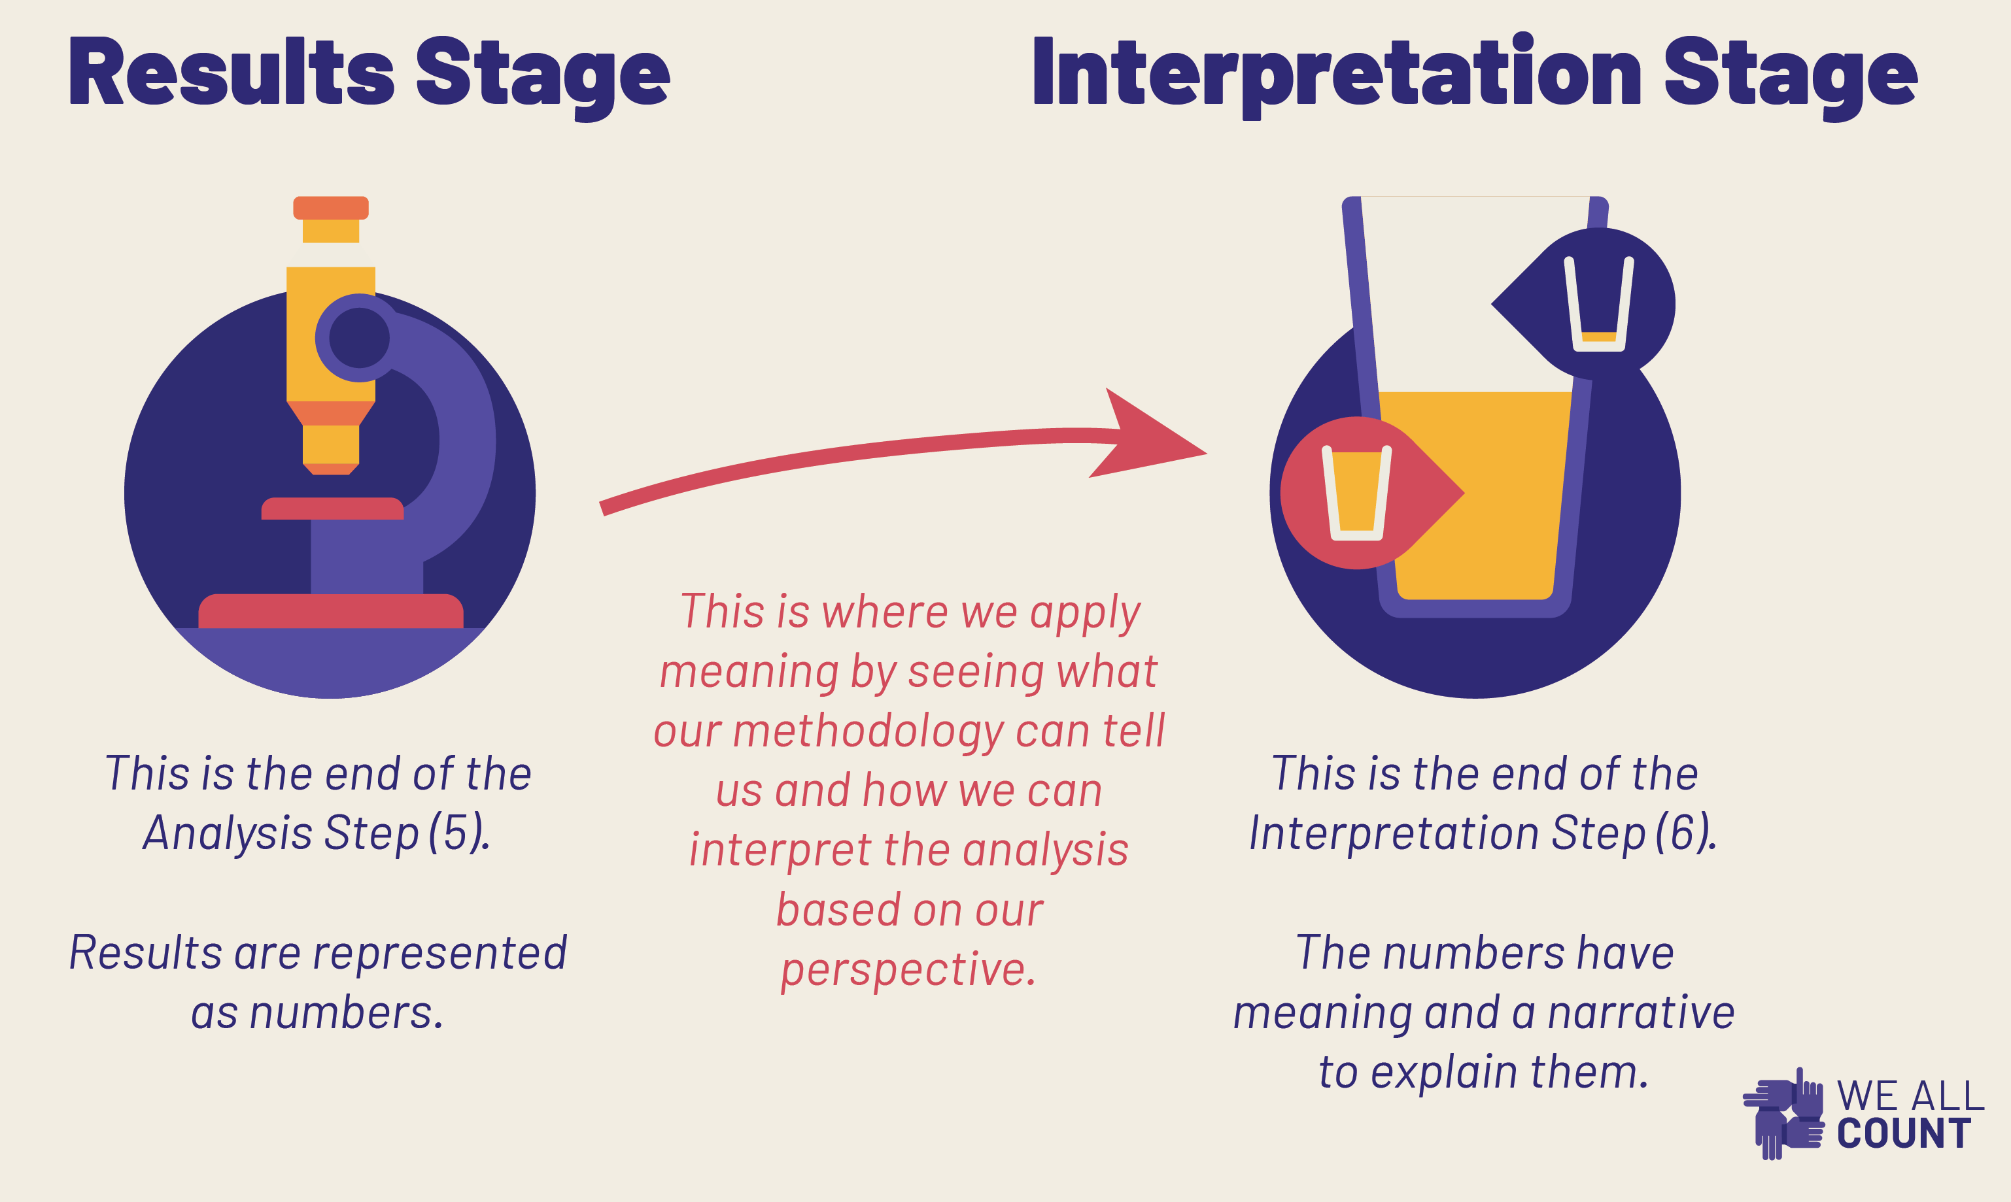
How – To Interpret
Opinion about meaning
Analysis of findings
Justified speculation
Notes:
https://weallcount.com/2019/12/03/result-or-interpretation/

Slide 20
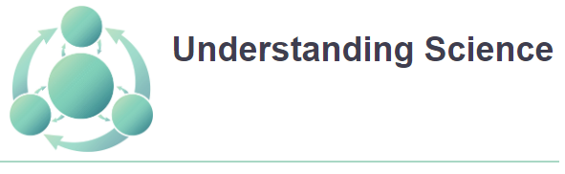
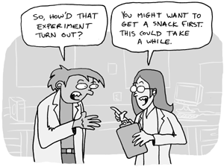
How – To Interpret
explicit connections back to your research question(s)
explain how the results might be generalized
make an argument that supports your main conclusions
interpret your results and explain what they mean
draw implications from your results
articulate why your results matter
Notes:
https://undsci.berkeley.edu/understanding-science-101/how-science-works/digging-into-data/

Slide 21
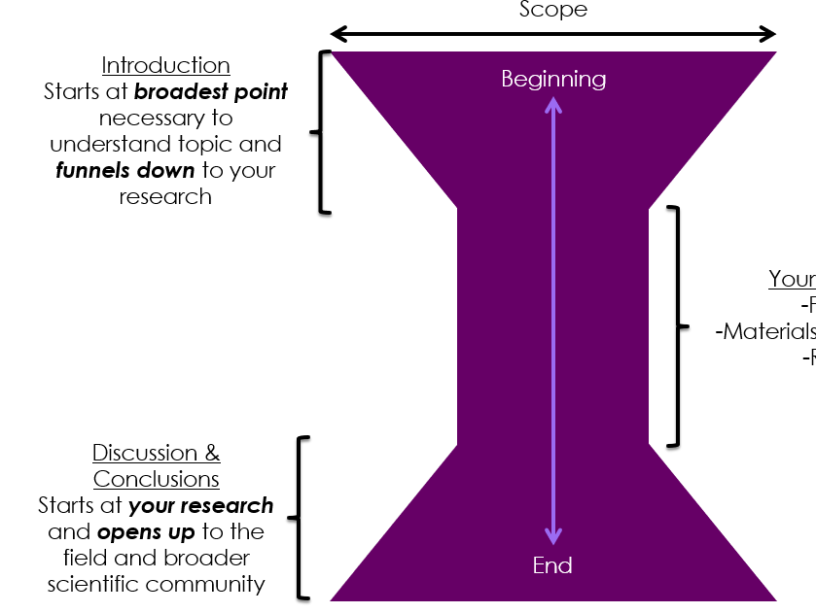

Where
IMRaD – After Results
Combined with Results
Notes:
https://butlerscicomm.com/scientific-paper-structure/

Slide 22
“More ‘art’ and ‘magic’ in a good discussion section than in any other part of a paper”
– Dr. Myron Toews

Slide 23
How – Grammar
The discussion is the probably the most complicated section – grammatically
– Dr. Toews
Past & Present & Future Tense
Active voice
First person – Some to all
Notes:
https://7esl.com/passive-voice/

Slide 24
How - Tense
Discussion Tenses
present tense vs. past tense
Past Tense - what you found
Present Tense - what it means
Future Tense – what will be done (in the future)
"… findings are that contraction was inhibited and phosphorylation was increased. These results suggest that enhancement contributes to contraction.“
“The present study investigated the impact of mindfulness-based interventions on stress reduction. Our findings provide valuable insights into the effectiveness of such interventions.”

Slide 25
How - Tense
Discussion Tenses
Future tense
Past Tense - what you found
Present Tense - what it means
Future Tense – what will be done (in the future)
such advancements will contribute to the development of ….
Future research should aim to investigate ….
future research will focus on the exploration of …

Slide 26
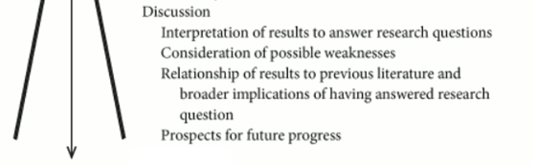
What - Elements
Interpretation of results to answer research question
Consideration of possible weaknesses
Relationship of results to previous literature
Broader implications of answering research question
Prospects for future progress

Slide 27
What – Interpret Results
Interpretation of results to answer research question
Usually at beginning of Discussion
Often occurs again at the end (“Conclusions”)
Some limited repetition of results often needed,
Looking to summarize and point out critical (and sometimes unexpected) results

Slide 28

What – Consider Weaknesses
Honest about the limitations of work
Mostly about study design
Less about technical aspects
Alternative explanations for results
Don’t go overboard
Use hedging
Likely, possible, implies

Slide 29
What – Relationship to Literature
How does your research fit into the broader field?
Support or contradict previous work?
Suggest a consensus in the field?
Suggest conflict in the field?
Raise new questions?

Slide 30
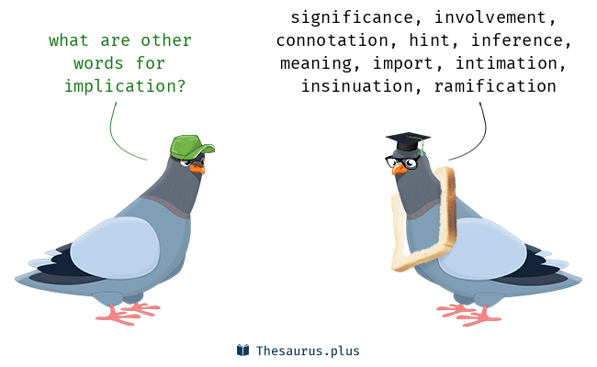
What – Broader Implications
How does your work move the field forward?
Are there economic, ecological, human-health implications?

Slide 31

What - Future Work
What steps are suggested by your work
Be specific, no “further research is needed”

Slide 32
What – Conclusions?
Some journals have it some don’t
It might reiterate research question and answer
It might state significance of the answer
It might identify directions for future research

Slide 33
Workshop: Discussion Dissections
Label text serving each of these five functions:
Interpret results to answer research question (yellow)
Consider possible weaknesses (pink)
Relate to previous literature (turquoise)
Consider broader implications (green)
Consider prospects for future progress (blue)
Highlight hedges (red). Are they excessive?
What is the function of the last 3 sentences – summary, major conclusion, or something else?

Slide 34
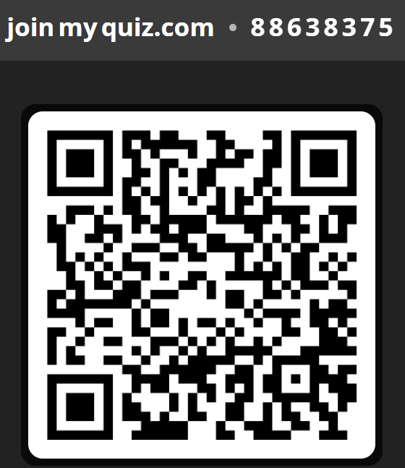
Small Group: Game
Active/Passive Voice
Figure/Table Criticisms
If active voice convert to passive, and reverse.
Make any other updates to clarify and shorten sentence
Right answers: 5 points
Wrong answers: 0 points
First right answer: +2 points
Best right answer: +2 points
Each issue identified: 2 points
First group to finish: 2 points

Slide 35
Assignment – Due 7/18
Writing
Revising
Discussion
Title
Abstract
Methods

Slide 36
Resources
https://www.cwauthors.com/article/Writing-a-compelling-results-and-discussion-section
https://weallcount.com/2019/12/03/result-or-interpretation/

